Slide 1



ANALYZING THE IMPACT OF CAR FEATURES ON PRICE AND PROFITABILITY
Trainity Project By Vaishakh Menon

Slide 2






Result
Insight
Content
Tech-Stack Used
Approach
Project Description

Slide 3
Project Description

Slide 4
The automotive sector has undergone significant changes in recent decades, emphasizing fuel efficiency, environmental sustainability, and technological advancements. Understanding the driving factors behind consumer demand for cars is now more crucial than ever due to heightened competition and evolving consumer preferences. The industry has witnessed a rise in electric and hybrid vehicles, as well as a growing interest in alternative fuel options like hydrogen and natural gas. Despite this, gasoline-powered cars continue to dominate the market, offering consumers a variety of fuel types and grades to choose from.
As a Data Analyst working with a specific dataset, the client seeks guidance on how car manufacturers can optimize pricing and product development decisions to enhance profitability while meeting consumer demand. This challenge can be addressed by examining the correlation between a car's features, market segment, and pricing, pinpointing the most popular features and categories among consumers, and determining the most profitable options for manufacturers. Through the application of data analysis tools like regression analysis and market segmentation, manufacturers can devise a pricing strategy that strikes a balance between consumer demand and profitability. Additionally, they can identify key product features to prioritize in future development endeavors, ultimately boosting their competitiveness and profitability in the market.

Slide 5
Approach

Slide 6
The research utilized various analytical techniques such as regression analysis, visualization, and descriptive statistics.
Descriptive statistics summarized key features of the dataset, providing insights into parameters like engine output, MPG, and MSRP.
Visualization techniques like scatter plots and line graphs helped explore linkages and patterns within the data, making it easier to identify relationships and anomalies.
Regression analysis, specifically linear regression, was employed to predict car prices based on market category and feature selection.
The project aimed to establish connections between independent factors and dependent variables to enable predictive analysis through fitting a linear model to the data. The project's objectives, which involved creating predictive models for price analysis and gaining insights into the automotive industry, influenced the choice of analytical techniques.
Challenges encountered included managing missing data, ensuring data quality, selecting appropriate regression models, and optimizing parameters for accurate automobile price prediction.

Slide 7
Tech-Stack Used

Slide 8


Microsoft Excel
Microsoft Powerpoint

Slide 9
Insight

Slide 10
Tasks: Analysis
Tasks 1
How does the popularity of a car model vary across different market categories?
Task A: Create a pivot table that shows the number of car models in each market category and their corresponding popularity scores.
Task B: Create a combo chart that visualizes the relationship between market category and popularity.
Reference:-Excel sheet

Slide 11
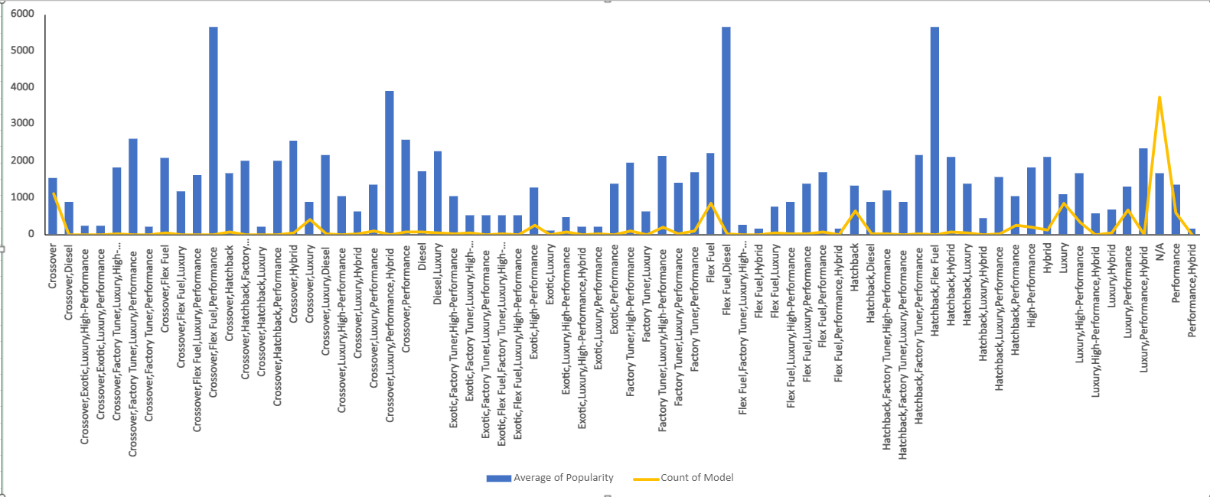
On an Average 5657 views on the market category “Flex Fuel,Diesel, Hatchback,Flex Fuel and Crossover,Flex Fuel,Performance had the highest average popularity.

Slide 12
Tasks: Analysis
Tasks 2
What is the relationship between a car's engine power and its price?
Task: Create a scatter chart that plots engine power on the x-axis and price on the y-axis. Add a trendline to the chart to visualize the relationship between these variables.

Slide 13
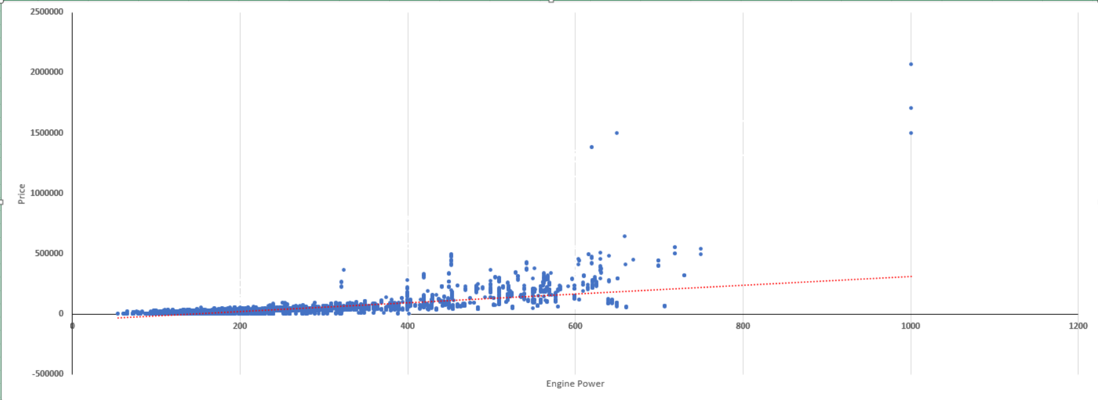
There seems to be a direct relationship between a car's price and its engine power (HP), as evidenced by the increasing costs linked to higher engine power. For instance, a car with 1001 HP is priced at $2,065,902, $1,705,769, and $1,500,000, demonstrating a clear correlation between engine power and price in these instances.

Slide 14
Tasks: Analysis
Tasks 3
Which car features are most important in determining a car's price?
Task: Use regression analysis to identify the variables that have the strongest relationship with a car's price. Then create a bar chart that shows the coefficient values for each variable to visualize their relative importance.

Slide 15
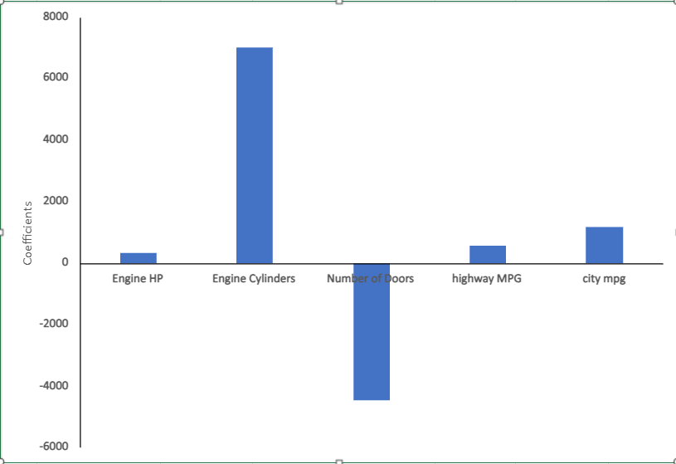
The research indicates that the engine cylinders have the highest correlation with a car's pricing, with a coefficient of 6993.27114258087. Conversely, the number of doors shows the least correlation with the price of a car, with a coefficient of -4469.66891049213. This suggests that the price of a car is predominantly influenced by the number of engine cylinders, while the number of doors plays a minor role in determining the price.

Slide 16
Tasks: Analysis
Tasks 4
How does the average price of a car vary across different manufacturers?
Task A: Create a pivot table that shows the average price of cars for each manufacturer.
Task B: Create a bar chart or a horizontal stacked bar chart that visualizes the relationship between manufacturer and average price.

Slide 17
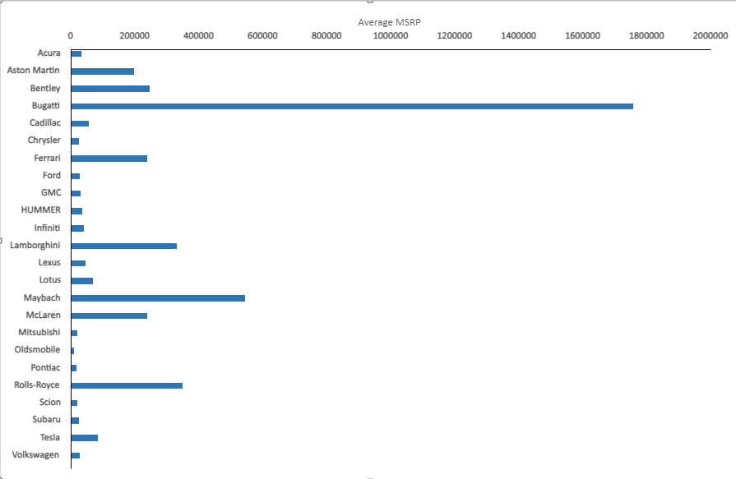
The data clearly indicates that Bugatti holds the top position among all brands, boasting the highest average price of $1,757,223. Maybach follows suit with an average price of $546,221. This information can prove to be immensely beneficial for car manufacturers in terms of their pricing and positioning endeavors.

Slide 18
Tasks: Analysis
Tasks 5
What is the relationship between fuel efficiency and the number of cylinders in a car's engine?
Task A: Create a scatter plot with the number of cylinders on the x-axis and highway MPG on the y-axis. Then create a trendline on the scatter plot to visually estimate the slope of the relationship and assess its significance.
Task B: Calculate the correlation coefficient between the number of cylinders and highway MPG to quantify the strength and direction of the relationship.

Slide 19
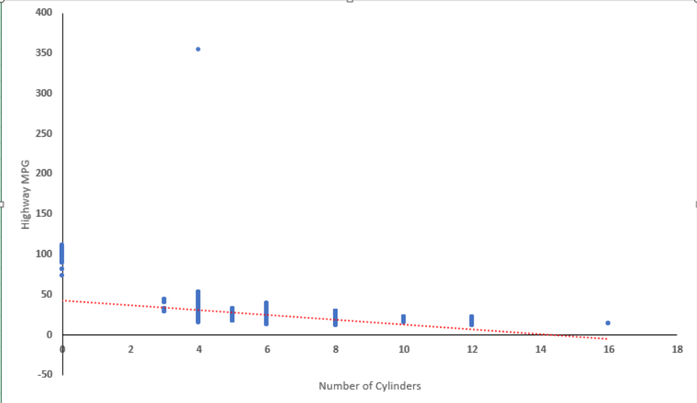
The investigation establishes a clear negative correlation between the number of engine cylinders and highway MPG. This correlation coefficient, calculated as -0.621605733, quantifies the strength and direction of the relationship. It confirms that as the cylinder count increases, the highway MPG tends to decrease, as evidenced by the automobile with 16 cylinders having the lowest highway MPG of 14.

Slide 20
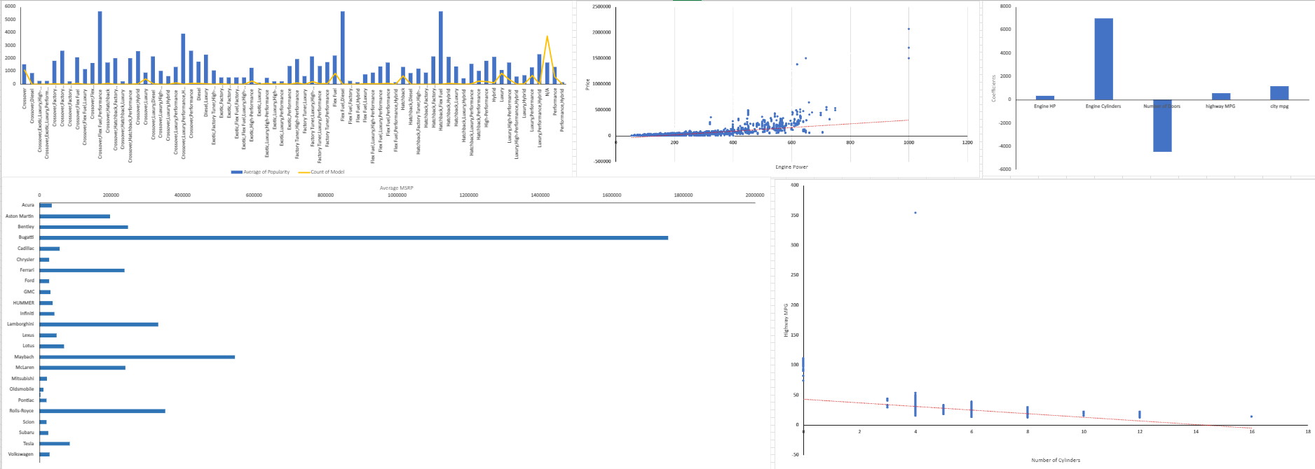
Tasks: Analysis Dashboard

Slide 21
Tasks: Building the Dashboard
Tasks 1
How does the distribution of car prices vary by brand and body style?
Utilize a stacked column chart to display the breakdown of car prices based on brand and body style. Enhance interactivity by incorporating filters and slicers. Determine the total Manufacturer's Suggested Retail Price (MSRP) for each brand and body style through the utilization of SUMIF or Pivot Tables.
Reference:-Excel sheet

Slide 22
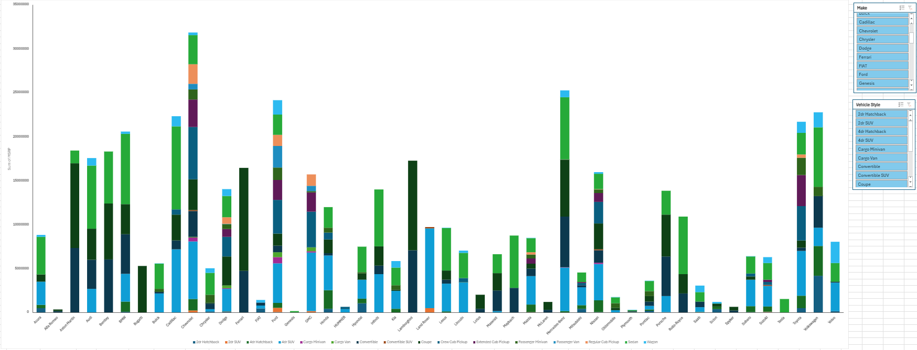
The findings of this study reveal that Mercedes-Benz ranks second with a total of $25,231,109, whereas Chevrolet takes the lead with an impressive $31,837,483, representing the highest cumulative prices. When considering different car types, sedans emerge as the costliest, reaching a total of $119,697,062, followed closely by 4-door SUVs at $100,569,617. These observations provide valuable insights for the car industry's marketing plans, product development, and pricing strategies.

Slide 23
Tasks: Building the Dashboard
Tasks 2
Which car brands have the highest and lowest average MSRPs, and how does this vary by body style?
Generate a clustered column chart to compare the mean MSRPs among different car brands and body styles. Employ AVERAGEIF or Pivot Tables to compute the average MSRP for each brand and body style.

Slide 24
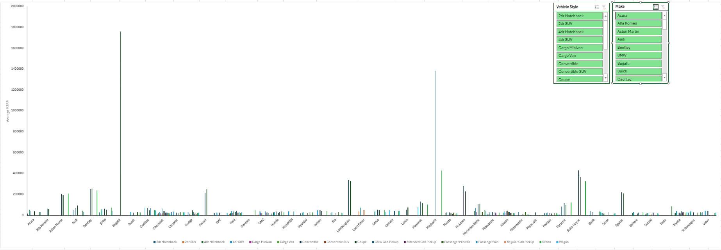
Analyzing different brands, Bugatti emerges as the leader with the highest average price of $1,757,223, closely trailed by Maybach at $546,221. In terms of body style, convertibles take the top spot with an average price of $84,224, while coupes follow closely behind at $76,248. On the other hand, Plymouth has the lowest average price per brand at $3,122, with Oldsmobile ranking second at $11,542.54. When considering body style, 2-door SUVs are the most affordable at $10,115, followed by 2-door hatchbacks at $16,867. This research provides valuable insights into price patterns across various car markets.

Slide 25
Tasks: Building the Dashboard
Tasks 3
How do the different feature such as transmission type affect the MSRP, and how does this vary by body style?
Use a scatter plot chart to visualize the association between MSRP and transmission type, assigning different symbols for each body style. Calculate the mean MSRP for every transmission type and body style pairing by utilizing AVERAGEIFS or Pivot Tables.

Slide 26
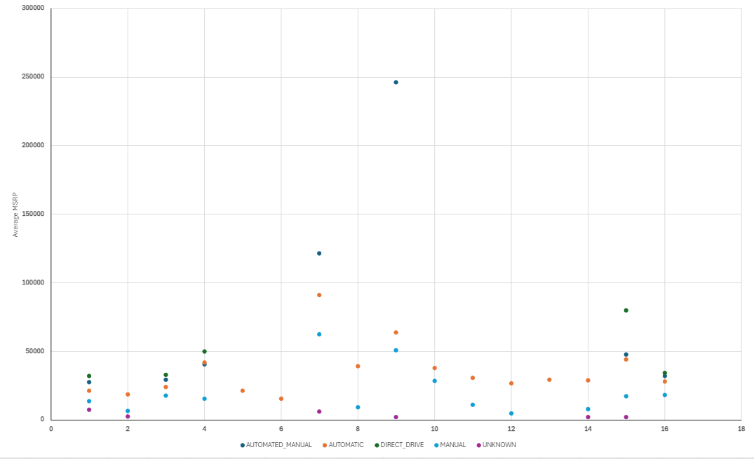
The examination of transmission types indicates that direct drive transmissions are priced at an average of $47,351.25, with automated manual transmissions following closely at $99,508.37. In terms of body shapes, coupes have an average price of $76,248.32, ranking second, while convertibles lead with an average price of $84,224.28. Conversely, manual transmissions are in second place at $26,663.64, and unknown transmissions have the lowest average price per gearbox type at $3,040.73. 2-door SUVs are the least expensive body shape, with an average price of $10,115.18, followed by 2-door hatchbacks at $16,867.71.

Slide 27
Tasks: Building the Dashboard
Tasks 4
How does the fuel efficiency of cars vary across different body styles and model years?
Employ a line chart to display the evolution of fuel efficiency (MPG) over time based on different body styles. Compute the average MPG for each body style and model year combination using either AVERAGEIFS or Pivot Tables.

Slide 28
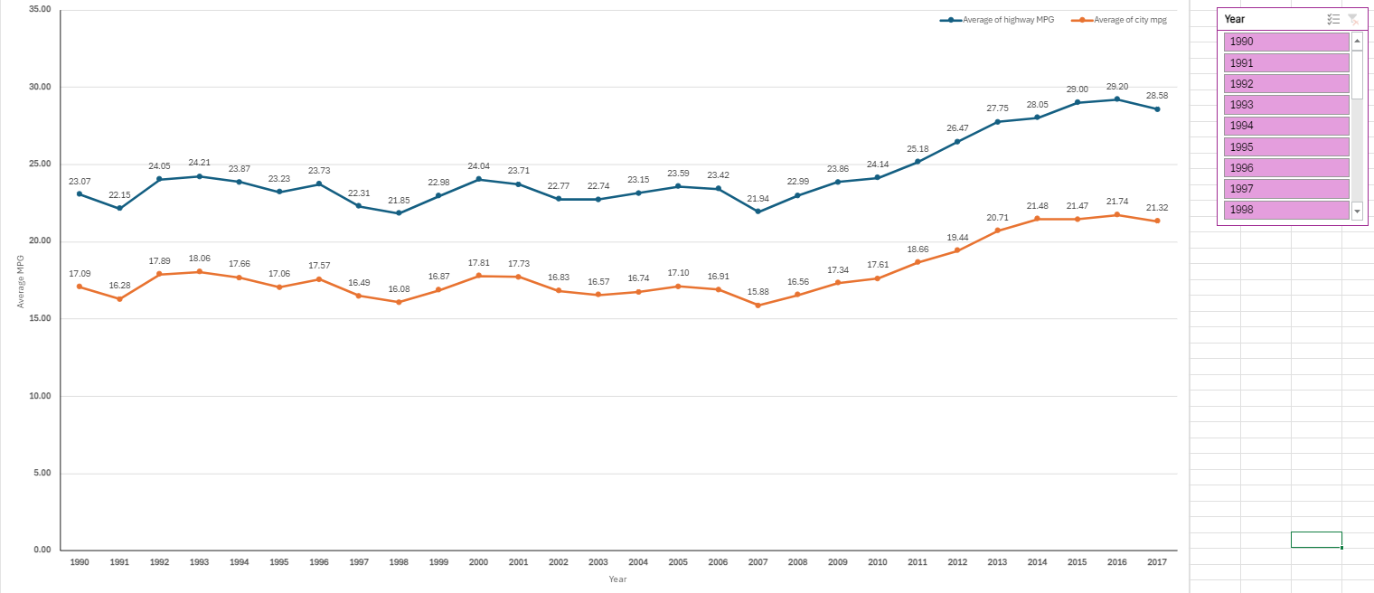
According to the line chart, there is a noticeable trend towards increased fuel efficiency as car model years progress, which can be attributed to advancements in automotive technology and regulations focused on reducing emissions and enhancing fuel economy. The most recent model year in our dataset is 2017. The highest average highway MPG of 40.29 achieved by 4-door hatchbacks in that year indicates ongoing endeavors to enhance fuel efficiency. Conversely, Passenger vans exhibit the lowest average highway MPG (19), highlighting the differences in fuel efficiency among various vehicle categories.

Slide 29
Tasks: Building the Dashboard
Tasks 5
What is the relationship between fuel efficiency and the number of cylinders in a car's engine?
Task A: Create a scatter plot with the number of cylinders on the x-axis and highway MPG on the y-axis. Then create a trendline on the scatter plot to visually estimate the slope of the relationship and assess its significance.
Task B: Calculate the correlation coefficient between the number of cylinders and highway MPG to quantify the strength and direction of the relationship.

Slide 30
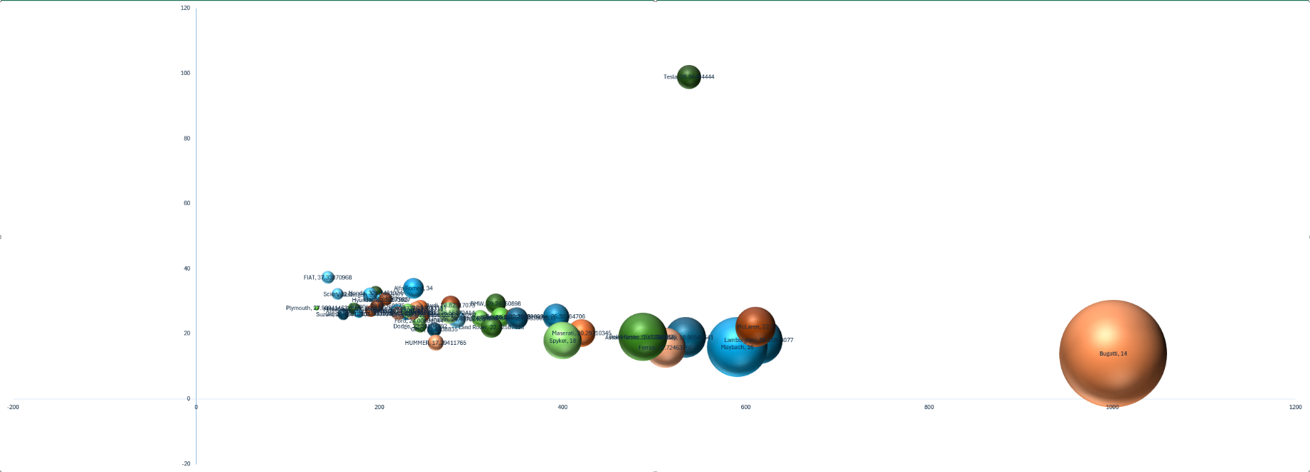
Bugatti excels in having the highest average engine horsepower (1001), the best average highway mileage (14), and the highest average cost ($1,757,223.66). In contrast, Tesla leads in the highest average highway MPG (98.94), the top average engine horsepower (538), and the highest average price ($85,255.55).
In summary, individuals seeking unparalleled performance will be drawn to Bugatti's high-performance vehicles due to their superior engine power and pricing. On the other hand, Tesla's focus on electric cars showcases their exceptional price and fuel efficiency, appealing to environmentally conscious customers. This comparison underscores the diverse goals and preferences present in the automotive industry, catering to a wide range of customers with varying needs and interests.

Slide 31
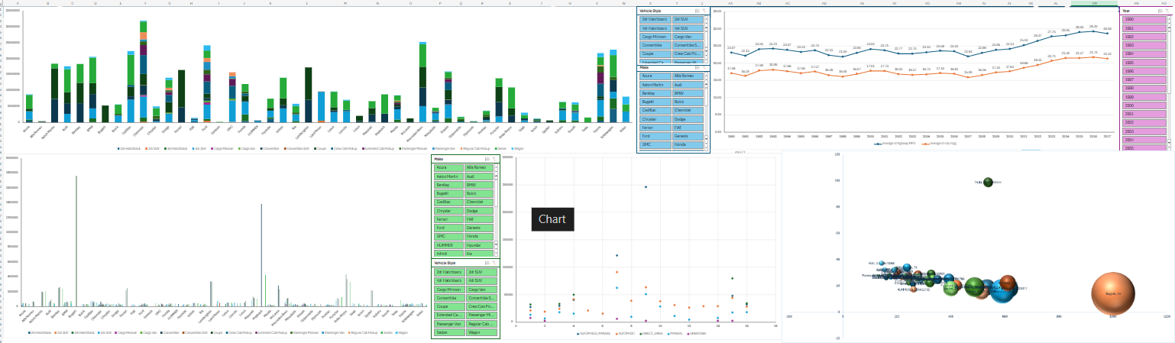
Tasks: Dashboard

Slide 32
Result
The insights gained from this study have greatly expanded my understanding of the automobile industry. I have learned about the evolving vehicle features, price dynamics, and fuel economy within this sector. It is evident that engine power and price are interconnected, market segments play a role in determining car popularity, and gearbox type influences pricing.

Slide 33
THANK YOU
SO MUCH!

